Slide 1
Subtitle

Slide 2



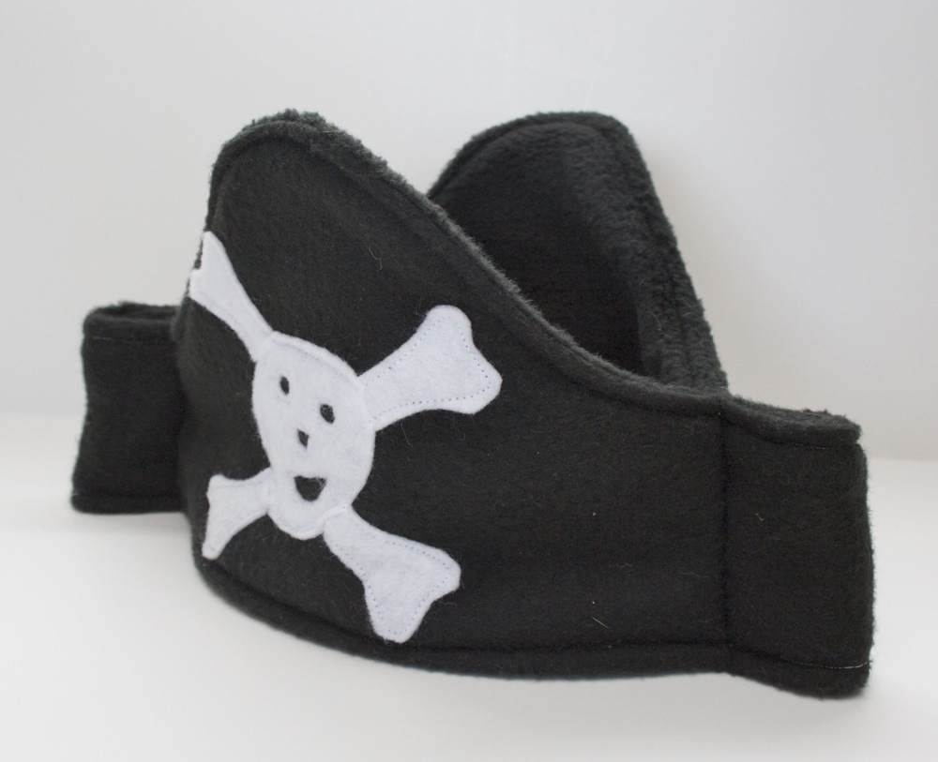






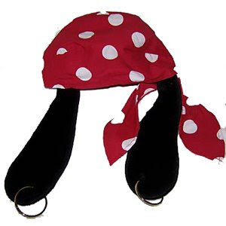
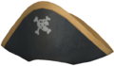




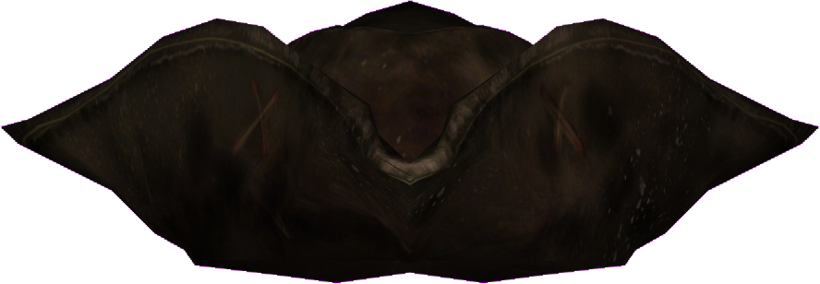
This Photo by Unknown Author is licensed under CC BY-SA-NC
PIRATE ASSETS
This Photo by Unknown Author is licensed under CC BY-SA-NC
This Photo by Unknown Author is licensed under CC BY-SA
This Photo by Unknown Author is licensed under CC BY-SA
This Photo by Unknown Author is licensed under CC BY-SA
This Photo by Unknown Author is licensed under CC BY-SA-NC
This Photo by Unknown Author is licensed under CC BY-SA
This Photo by Unknown Author is licensed under CC BY-NC-ND
This Photo by Unknown Author is licensed under CC BY-SA
This Photo by Unknown Author is licensed under CC BY-SA-NC
This Photo by Unknown Author is licensed under CC BY-SA
This Photo by Unknown Author is licensed under CC BY-SA-NC
This Photo by Unknown Author is licensed under CC BY-NC-ND
This Photo by Unknown Author is licensed under CC BY-SA-NC
This Photo by Unknown Author is licensed under CC BY-SA-NC

Slide 3





























This Photo by Unknown Author is licensed under CC BY-SA-NC
This Photo by Unknown Author is licensed under CC BY-SA-NC
This Photo by Unknown Author is licensed under CC BY-NC
This Photo by Unknown Author is licensed under CC BY-NC-ND
This Photo by Unknown Author is licensed under CC BY-SA
This Photo by Unknown Author is licensed under CC BY-NC
This Photo by Unknown Author is licensed under CC BY-SA
This Photo by Unknown Author is licensed under CC BY-NC
This Photo by Unknown Author is licensed under CC BY-NC
This Photo by Unknown Author is licensed under CC BY-NC
This Photo by Unknown Author is licensed under CC BY-SA
This Photo by Unknown Author is licensed under CC BY-NC
This Photo by Unknown Author is licensed under CC BY-SA
This Photo by Unknown Author is licensed under CC BY-NC
This Photo by Unknown Author is licensed under CC BY-NC
This Photo by Unknown Author is licensed under CC BY-NC
This Photo by Unknown Author is licensed under CC BY-NC
This Photo by Unknown Author is licensed under CC BY-NC
This Photo by Unknown Author is licensed under CC BY-NC
This Photo by Unknown Author is licensed under CC BY-NC
This Photo by Unknown Author is licensed under CC BY-NC-ND
This Photo by Unknown Author is licensed under CC BY-NC
This Photo by Unknown Author is licensed under CC BY-NC
This Photo by Unknown Author is licensed under CC BY-NC
This Photo by Unknown Author is licensed under CC BY-NC
This Photo by Unknown Author is licensed under CC BY-NC-ND
This Photo by Unknown Author is licensed under CC BY-NC
This Photo by Unknown Author is licensed under CC BY-NC
This Photo by Unknown Author is licensed under CC BY-NC

Slide 4








Slide 5




Slide 7







Slide 8



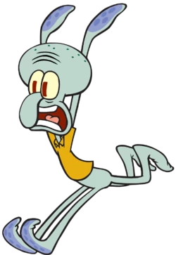

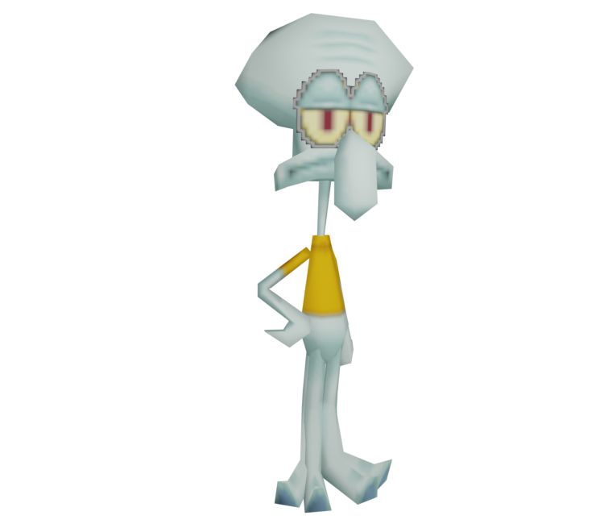
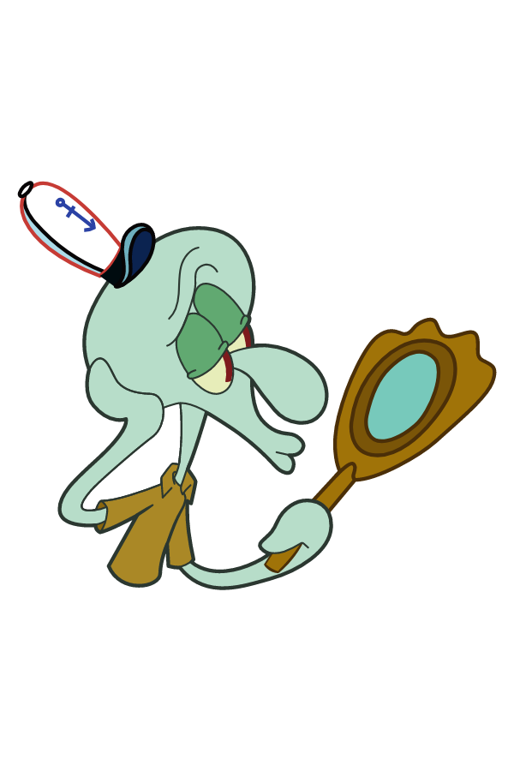



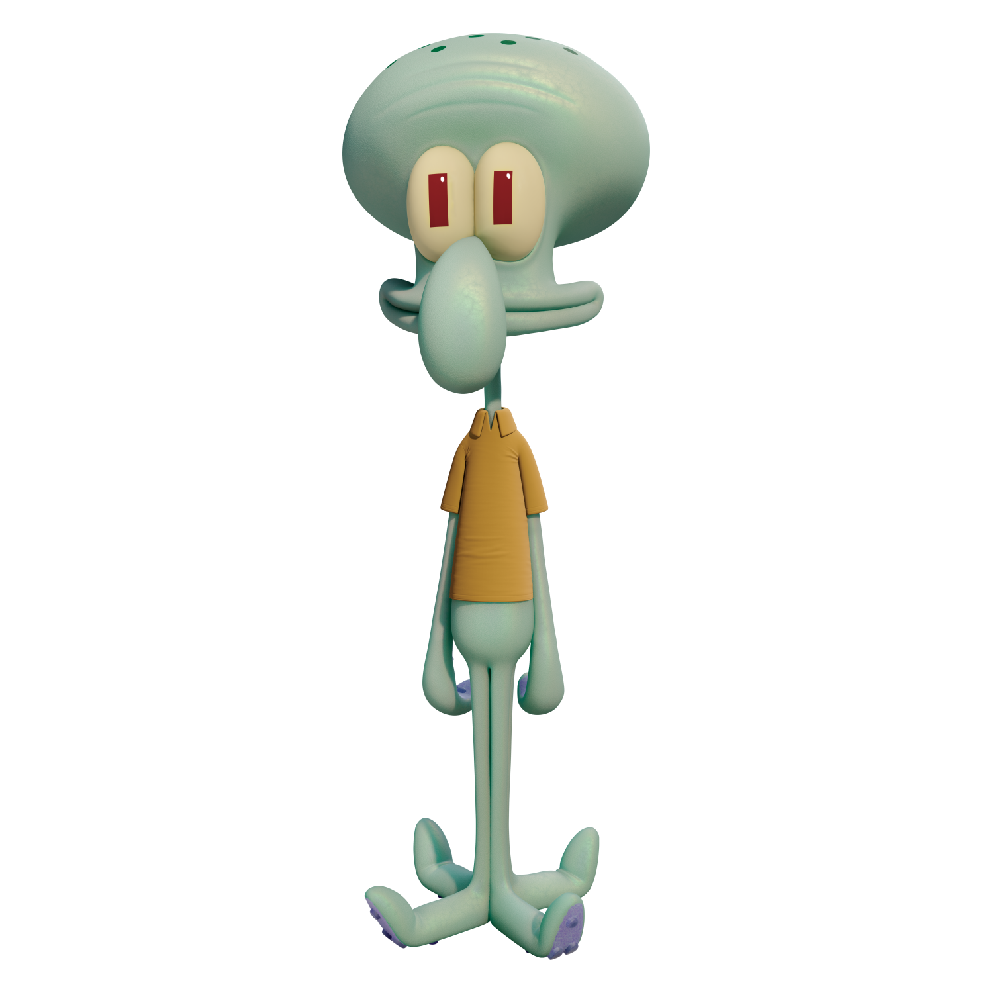



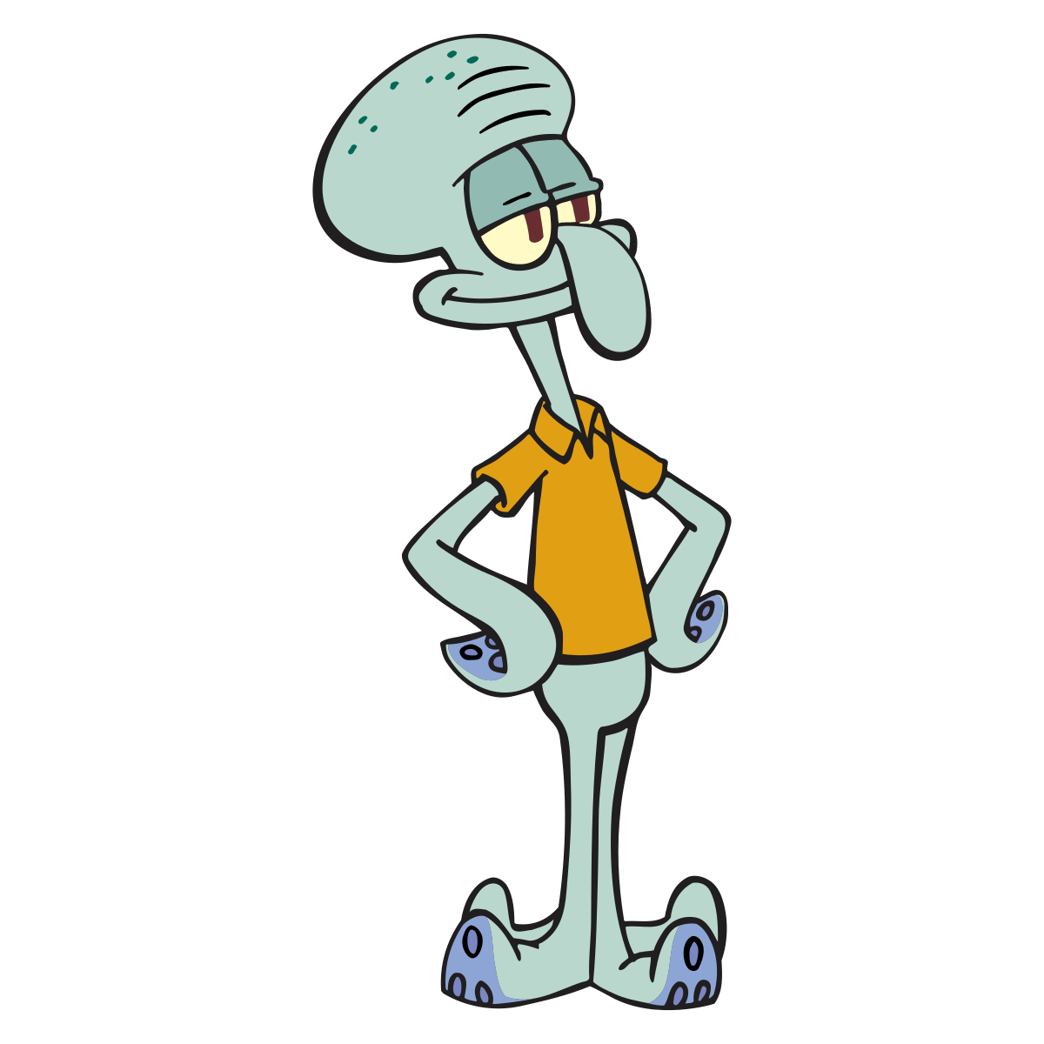



Slide 9
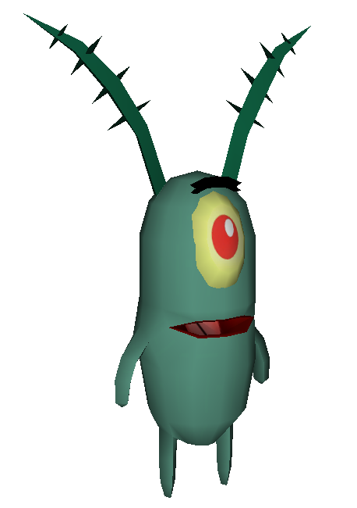








Slide 10







Slide 11


A reanimation of a film by
Paramount Pictures
Nickelodeon Movies
& United Plankton Pictures
With audio from
The Spongebob Squarepants
Movie Rehydrated
RGC Exists
Presents

Slide 16
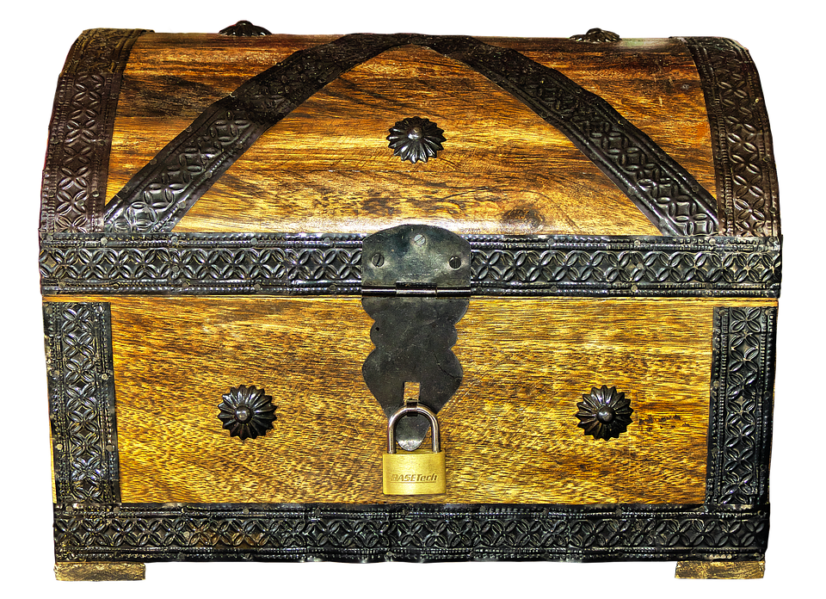

-I got it! I got it! I got it!

Slide 19
-Dinghy ahoy.

Slide 20


Slide 21
Dinghy off the port bow!
Dinghy off the port bow!
This Photo by Unknown Author is licensed under CC BY-SA-NC

Slide 22
Dinghy off the port bow!
Dinghy off the port bow!
This Photo by Unknown Author is licensed under CC BY-SA-NC

Slide 23
Dinghy off the port bow!
Dinghy off the port bow!
This Photo by Unknown Author is licensed under CC BY-SA-NC

Slide 24
-Dinghy off the port bow!
This Photo by Unknown Author is licensed under CC BY-SA-NC

Slide 25
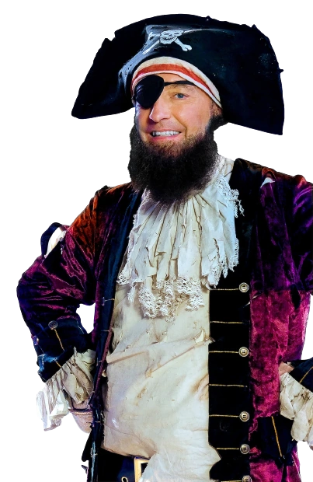
-Captain! Dinghy off the--

Slide 26
-Captain! Dinghy off the--

Slide 27
-Dinghy.

Slide 28
-I got it! I got it! I got it!

Slide 29


Slide 30
-Where is it?

Slide 31
-Where is it?

Slide 32
-It’s right here, captain.

Slide 33
-It’s right here, captain.

Slide 36
-I never thought I’d see it with me own eye.

Slide 37


Tickets to the spongebob movie!

Slide 38
Tickets to the spongebob movie!

Slide 39

ALL: -Hurrah! Yeah!

Slide 40
UNFINISHED SECTION

Slide 41


Narrator: Ah, the sea. So mysterious, so beautiful.

Slide 42
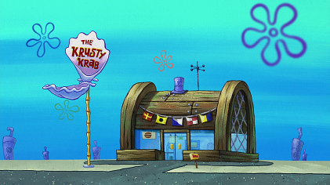
So uhhh… Wet.

Slide 43
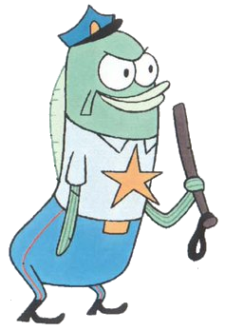
Our story begins In Bikini Bottom’s popular undersea eatery, the Krusty Krab restaurant, where--

Slide 44
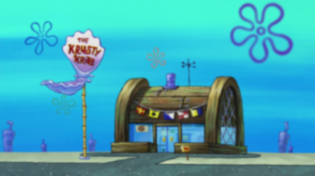
-Back up! Back up!

Slide 45
-Back up! Back up!

Slide 46
Narrator: Hey. Wait a minute…
What is happening?

Slide 47
Narrator: Hey. Wait a minute…
What is happening?

Slide 48

-Please, please, settle down!

Slide 49
We’ve got a situation in there. I’d rather not discuss till me manager gets here.

Slide 50
-Look! There he is!

Slide 51
-Look! There he is!

Slide 52
-Look! There he is!

Slide 53
-Talk to me Krabs.

Slide 54
-It started with a simple order. A Krabby Patty with cheese…

Slide 55
But when the customer took a bite…

Slide 56
NO CHEEEESE!

Slide 57
*Sobbing*

Slide 58
*Sobbing*

Slide 59
-Get ahold of yourself Eugene.

Slide 60
I’m going in.

Slide 61
UNFINISHED SECTION

Slide 62
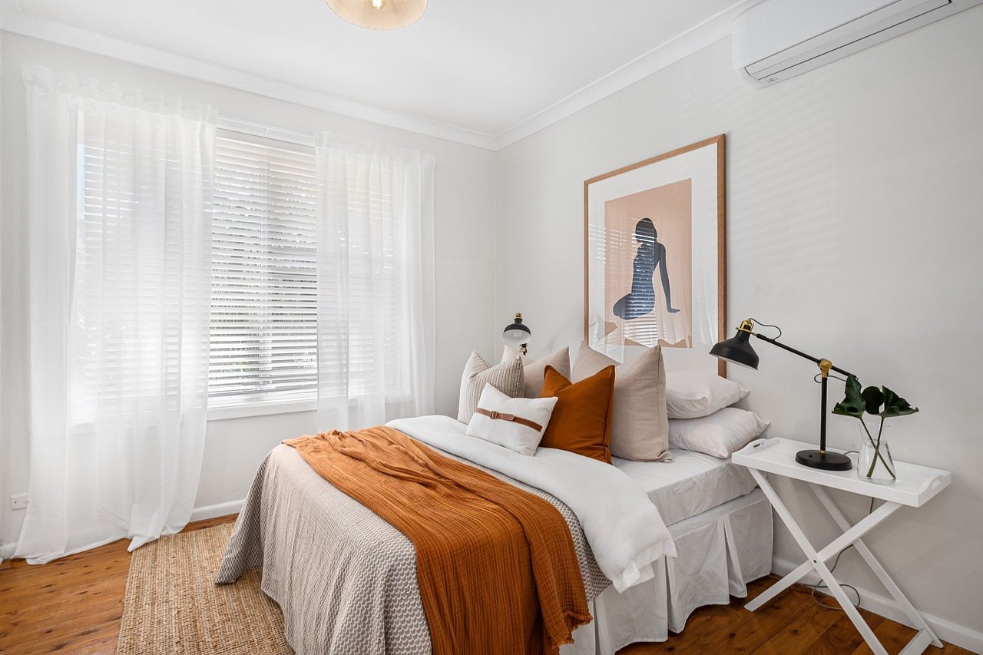
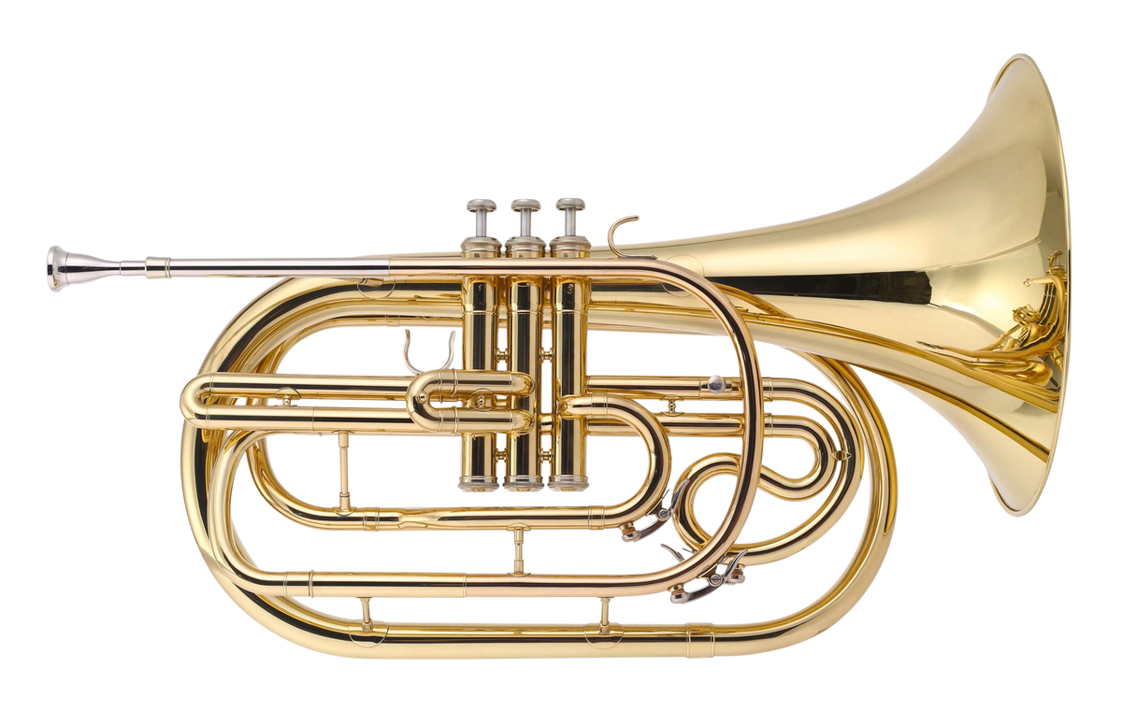
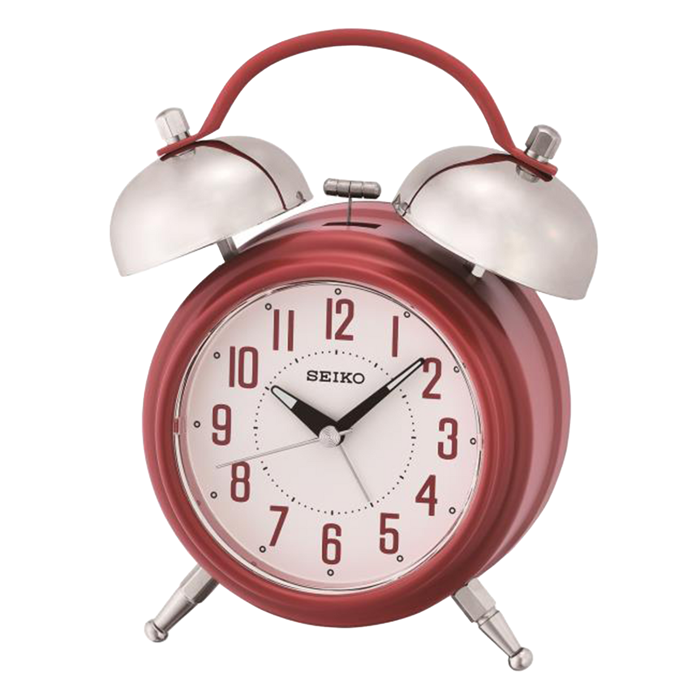

[Horn blows]

Slide 64
Hooray!

Slide 65

Gary, I had that dream again!

Slide 66
Gary, I had that dream again!

Slide 67


Slide 68


And it’s finally gonna come true, today!
MARCH
9
WILL YOU SNAIL RELEASE DATE
(Underrated game)

Slide 69
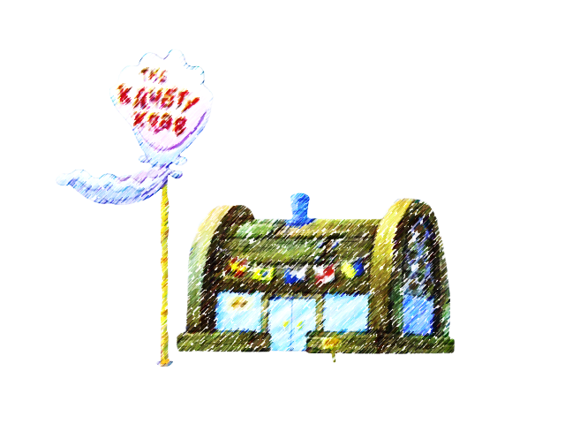
Sory about this calender…
MARCH
10
KRUSTY KRAB 2 OPENS
MARCH
9
WILL YOU SNAIL RELEASE DATE
(Underrated game)

Slide 70
Sory about this calender…
MARCH
10
KRUSTY KRAB 2 OPENS
MARCH
9
WILL YOU SNAIL RELEASE DATE
(Underrated game)

Slide 71
Because today’s the grand opening ceremony of the Krusty Krab 2!
MARCH
10
KRUSTY KRAB 2 OPENS

Slide 72
Where Mr Krabs will announce the new manager!
MARCH
10
KRUSTY KRAB 2 OPENS

Slide 73
Who’s it gonna be, gary?

Slide 74
(Chuckles)

Slide 75
Well, let’s ask my wall of 374 CONSECUTIVE employee of the month awards!

Slide 76
Well, let’s ask my wall of 374 CONSECUTIVE employee of the month awards!

Slide 77
ALL: SpongebobSquarepants!

Slide 78
-I’m ready! Promotion!

Slide 79
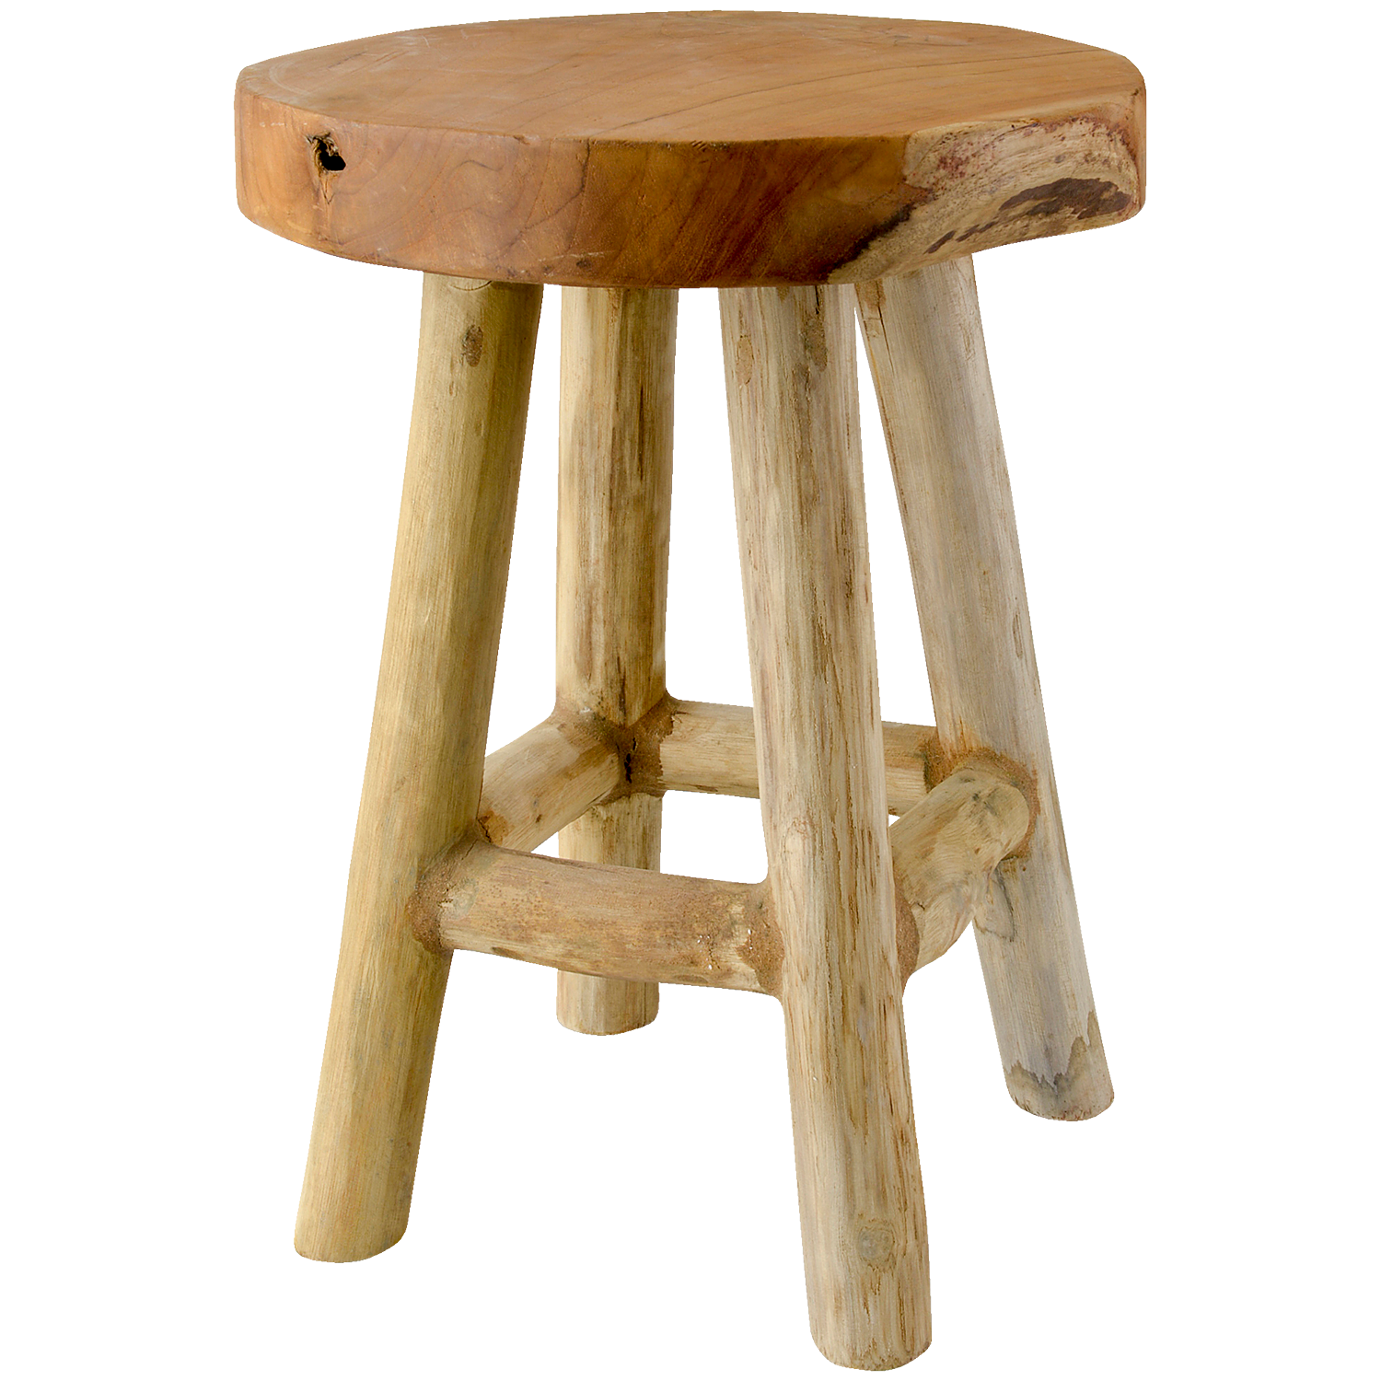

Slide 80
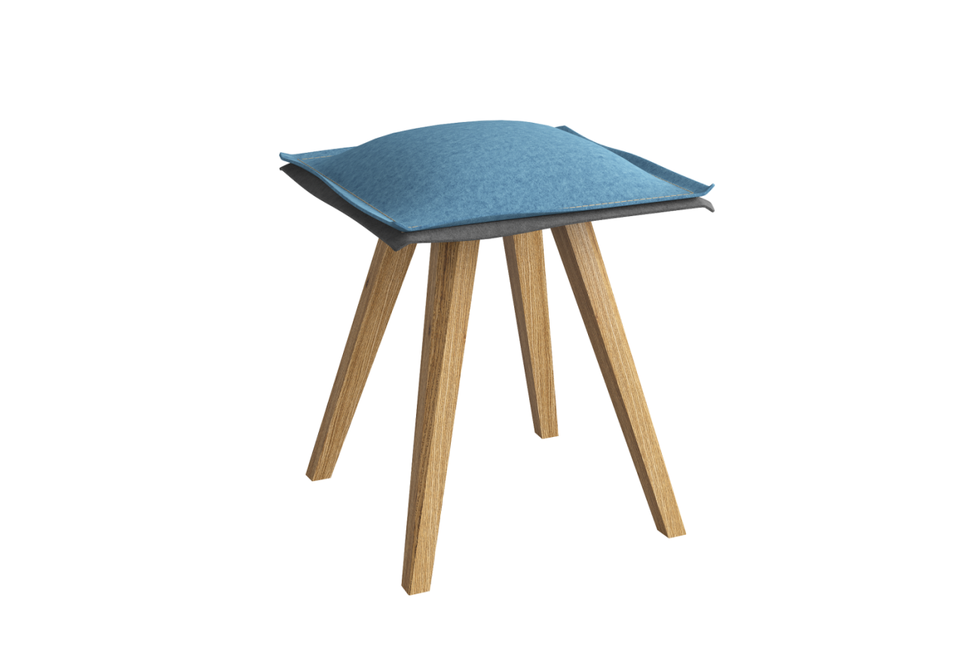
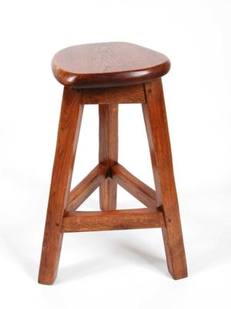

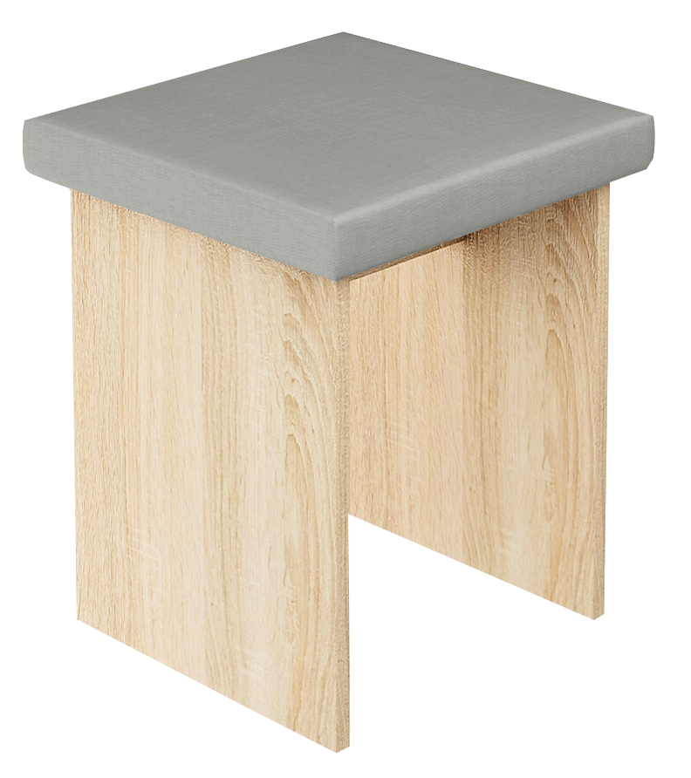
This Photo by Unknown Author is licensed under CC BY-SA

Slide 81
This Photo by Unknown Author is licensed under CC BY-SA

Slide 82
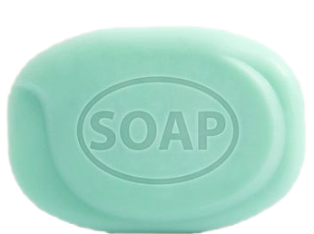

Slide 85
This Photo by Unknown Author is licensed under CC BY-SA

Slide 86
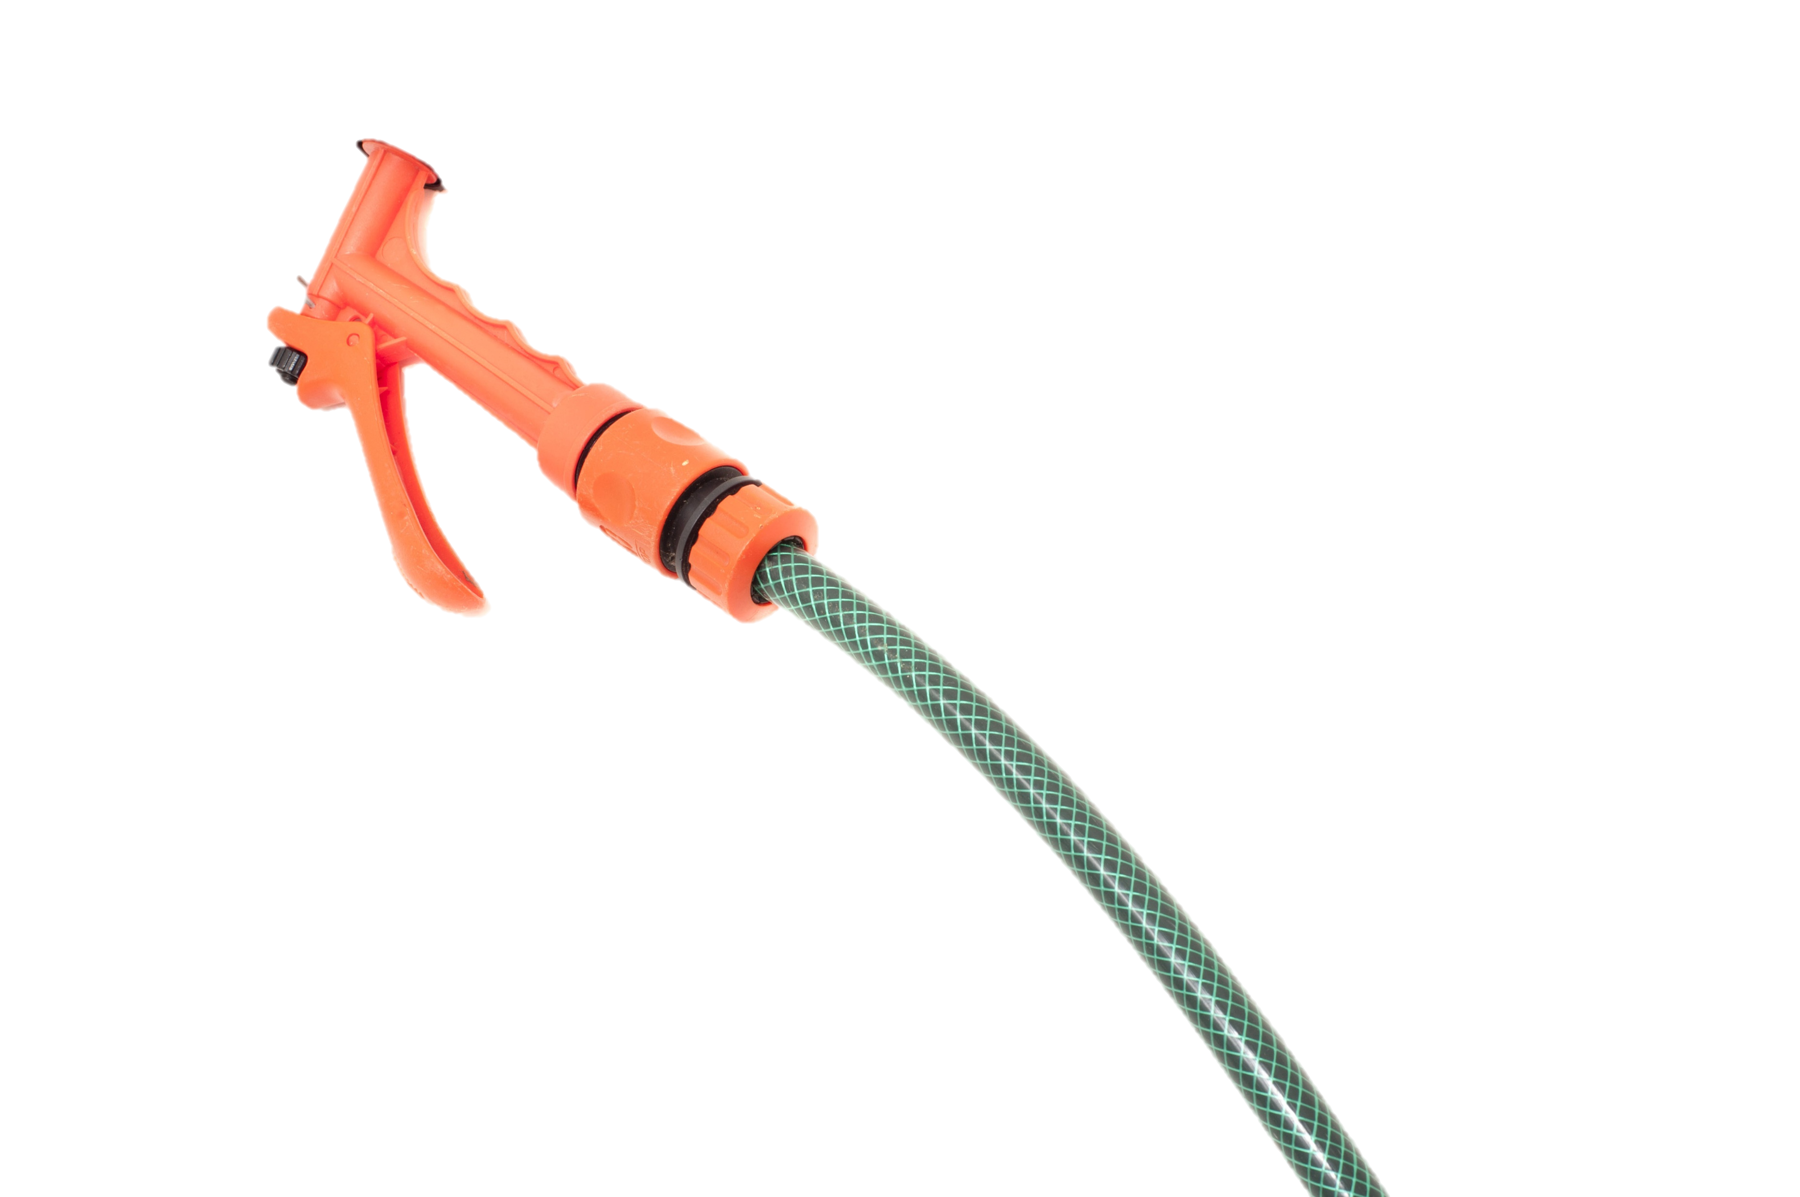
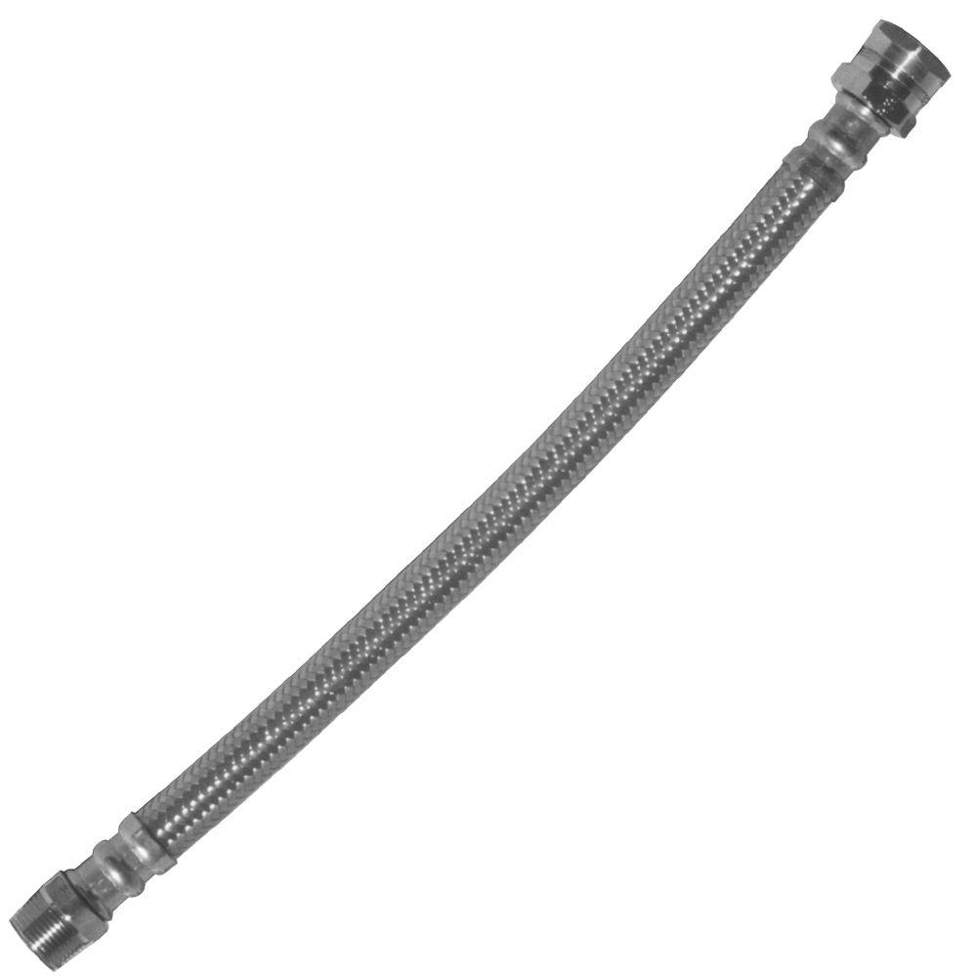
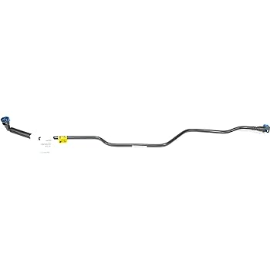
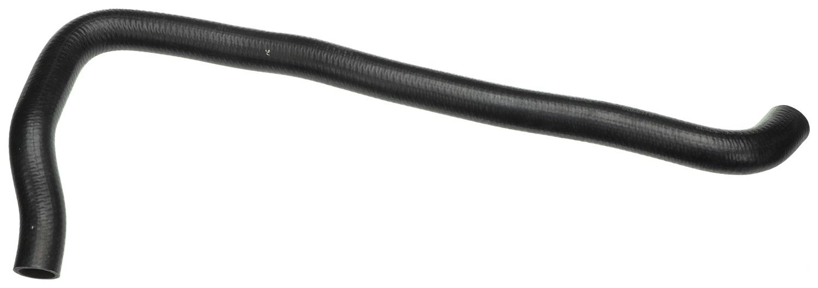
This Photo by Unknown Author is licensed under CC BY-SA
This Photo by Unknown Author is licensed under CC BY
This Photo by Unknown Author is licensed under CC BY
This Photo by Unknown Author is licensed under CC BY
This Photo by Unknown Author is licensed under CC BY
This Photo by Unknown Author is licensed under CC BY-SA
This Photo by Unknown Author is licensed under CC BY-SA

Slide 87
This Photo by Unknown Author is licensed under CC BY-SA
This Photo by Unknown Author is licensed under CC BY
This Photo by Unknown Author is licensed under CC BY
This Photo by Unknown Author is licensed under CC BY
This Photo by Unknown Author is licensed under CC BY
This Photo by Unknown Author is licensed under CC BY-SA
This Photo by Unknown Author is licensed under CC BY-SA

Slide 88

This Photo by Unknown Author is licensed under CC BY-SA
This Photo by Unknown Author is licensed under CC BY
This Photo by Unknown Author is licensed under CC BY
This Photo by Unknown Author is licensed under CC BY
This Photo by Unknown Author is licensed under CC BY
This Photo by Unknown Author is licensed under CC BY-SA
This Photo by Unknown Author is licensed under CC BY-SA

Slide 89

This Photo by Unknown Author is licensed under CC BY-SA
This Photo by Unknown Author is licensed under CC BY
This Photo by Unknown Author is licensed under CC BY
This Photo by Unknown Author is licensed under CC BY
This Photo by Unknown Author is licensed under CC BY
This Photo by Unknown Author is licensed under CC BY-SA
This Photo by Unknown Author is licensed under CC BY-SA

Slide 90
This Photo by Unknown Author is licensed under CC BY-SA
This Photo by Unknown Author is licensed under CC BY
This Photo by Unknown Author is licensed under CC BY
This Photo by Unknown Author is licensed under CC BY
This Photo by Unknown Author is licensed under CC BY
This Photo by Unknown Author is licensed under CC BY-SA
This Photo by Unknown Author is licensed under CC BY-SA

Slide 91
This Photo by Unknown Author is licensed under CC BY-SA
This Photo by Unknown Author is licensed under CC BY
This Photo by Unknown Author is licensed under CC BY
This Photo by Unknown Author is licensed under CC BY
This Photo by Unknown Author is licensed under CC BY
This Photo by Unknown Author is licensed under CC BY-SA
This Photo by Unknown Author is licensed under CC BY-SA

Slide 92
UNFINISHED SECTION

Slide 93



Slide 94
UNFINISHED SECTION

Slide 96
-Patrick! You call that a distraction?
(Toilet flushes)

Slide 97
-Patrick! You call that a distraction?
(Toilet flushes)

Slide 98
-I had to go to the bathroom.

Slide 99
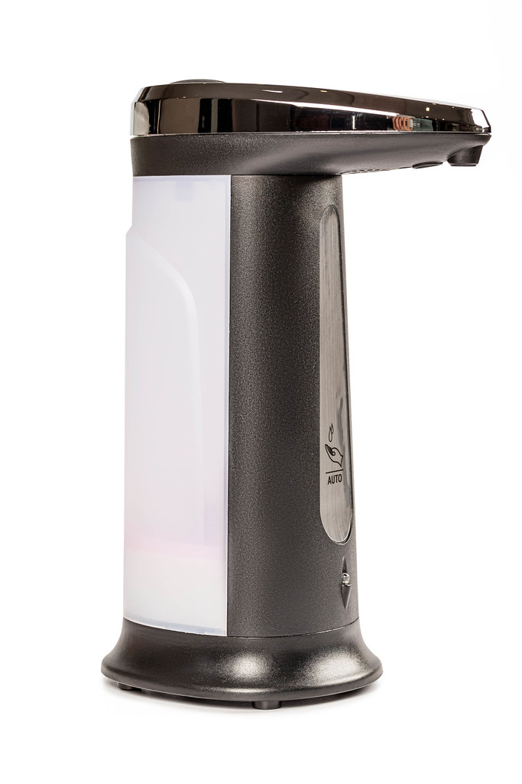
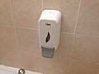
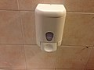
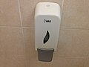
-Well, I got my hands dirty for nothing
This Photo by Unknown Author is licensed under CC BY-SA
This Photo by Unknown Author is licensed under CC BY-SA
This Photo by Unknown Author is licensed under CC BY-SA
This Photo by Unknown Author is licensed under CC BY

Slide 100

-Well, I got my hands dirty for nothing
This Photo by Unknown Author is licensed under CC BY-SA
This Photo by Unknown Author is licensed under CC BY-SA
This Photo by Unknown Author is licensed under CC BY-SA
This Photo by Unknown Author is licensed under CC BY

Slide 101
Huh?
This Photo by Unknown Author is licensed under CC BY-SA
This Photo by Unknown Author is licensed under CC BY-SA
This Photo by Unknown Author is licensed under CC BY-SA
This Photo by Unknown Author is licensed under CC BY
This Photo by Unknown Author is licensed under CC BY-NC

Slide 102
Patrick, check it out!
This Photo by Unknown Author is licensed under CC BY-SA
This Photo by Unknown Author is licensed under CC BY-SA
This Photo by Unknown Author is licensed under CC BY-SA
This Photo by Unknown Author is licensed under CC BY
This Photo by Unknown Author is licensed under CC BY-NC

Slide 103
Patrick, check it out!

Slide 104
UNFINISHED SECTION

Slide 105
I guess you’re right plankton.

Slide 106
I am just a kid.

Slide 107

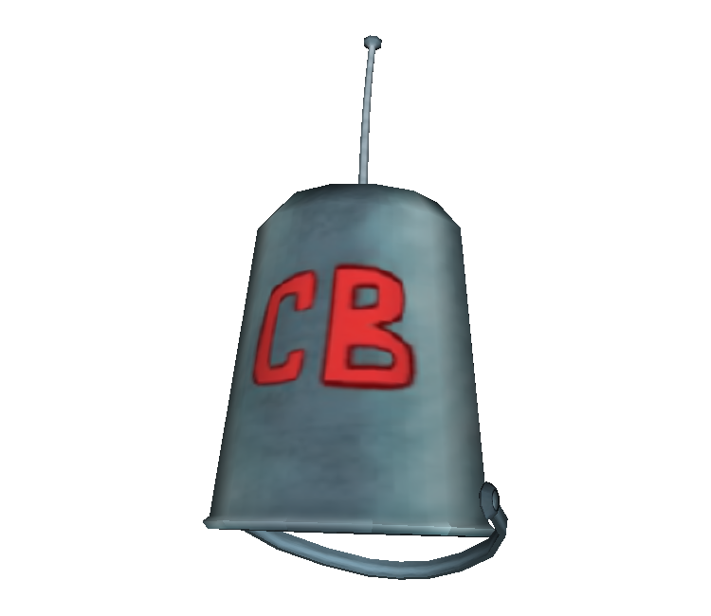





-Of course I’m right. Okay, Neptune time to kill.

Slide 108
-Of course I’m right. Okay, Neptune time to kill.

Slide 109
-And you know,

Slide 110
I’ve been through a lot in the past six days, five minutes, 27-and-a-half seconds.

Slide 111
And if I’ve learned anything during that time,

Slide 112
It’s that you are who you are.

Slide 113
-That’s right. Okay, Neptune-

Slide 114
-That’s right. Okay, Neptune-

Slide 115
And no amount of mermaid magic…

Slide 116
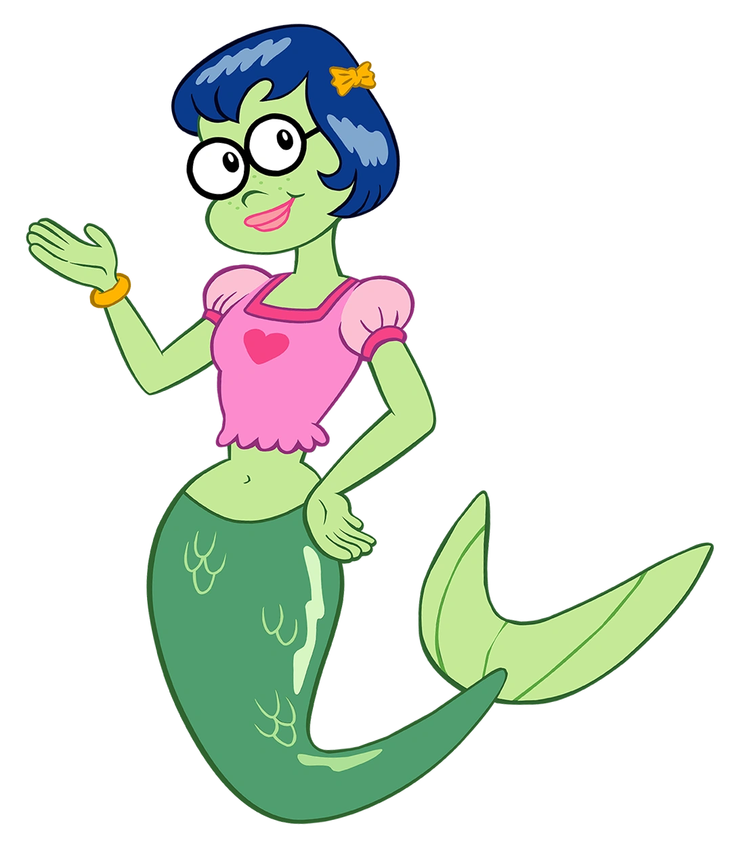

Slide 117
Or managerial promotion…

Slide 118


Slide 119
Or some other third thing…

Slide 120
Can make me anything more than what I really am inside...

Slide 121
A kid.

Slide 122
-That’s great. Now get back against the wall.

Slide 123
-But that’s okay!

Slide 124
-What? What’s going on?

Slide 125
Because I did what everyone said a kid couldn’t do!

Slide 126
I made it to shell city, and I beat the cyclops,

Slide 127
And I rode the Hasselhoff, and I brought the crown BACK!

Slide 128
And I rode the Hasselhoff, and I brought the crown BACK!

Slide 129
-Alright we get the point.

Slide 130
-So yeah I’m a kid,

Slide 131

And I’m also, a goofball, and a wing nut, and a Knucklehead McSpazatron!

Slide 132
And I’m also, a goofball, and a wing nut, and a Knucklehead McSpazatron!

Slide 133
-What?

Slide 134
(Coughing)

Slide 135
What’s going on here?

Slide 136
-But most of all, I’m…

Slide 137
-Okay, settle down.

Slide 138
-I’m…

Slide 139
-Take it easy.

Slide 140
-I’m…
-What the scallop?

Slide 141


-I’m a goofy goober!

Slide 142
THE END (SO FAR)

